Slide 1
What is Data Engineering?

Slide 2
A supervised AI is trained on a corpus of training data.

Slide 3
Original Dataset

Slide 4
Original Dataset
Training Set
Test Set
Notes:
The sample of data used to fit the model.
A test dataset is a dataset that is independent of the training dataset, but that follows the same probability distribution as the training dataset. If a model fit to the training dataset also fits the test dataset well, minimal overfitting has taken place (see figure below). A better fitting of the training dataset as opposed to the test dataset usually points to overfitting.
Test Dataset: The sample of data used to provide an unbiased evaluation of a final model fit on the training dataset.

Slide 5
Original Dataset
Training Set
Test Set
Training Set
Validation Set
Test Set
Notes:
A validation dataset is a sample of data held back from training your model that is used to give an estimate of model skill while tuning model’s hyperparameters.

Slide 6
Original Dataset
Training Set
Test Set
Training Set
Validation Set
Test Set
Training, tuning,
evaluation
Machine Learning Algorithm
Notes:
https://thenounproject.com/search/?q=confused&i=1429617

Slide 7
Original Dataset
Training Set
Test Set
Training Set
Validation Set
Test Set
Training, tuning,
evaluation
Machine Learning Algorithm
Final Performance Estimate
Final Model
Notes:
https://thenounproject.com/search/?q=confused&i=1429617

Slide 8

Original Dataset
Training Set
Test Set
Training Set
Validation Set
Test Set
Training, tuning,
evaluation
Machine Learning Algorithm
Final Performance Estimate
Final Model
Notes:
https://thenounproject.com/search/?q=confused&i=1429617

Slide 9
Data Engineering is all
about datasets

Slide 10
Good Data is Necessary for Accuracy
What problem are you
trying to solve?
Notes:
Data engineering starts with a rigorous problem definition
Your training examples need to contain enough salient features for the ML algorithm to discover and use to discriminate between classes
If the photos are blurry / if the microphone recorded too much noise, the data might be unusable
If a human was given the same task, how difficult would it be for them to solve it?
Sometimes machine learning models can outperform an average human, but ML cannot solve impossible problems
You can’t train a model to win the lottery, no matter how much data you have
in supervised learning a a human (maybe an expert) still needs to label each example with the ground truth value before you can train a model
As a data engineer you need to think about evaluation metrics at the outset
How will you know your model is improving as it is trained on more and more data?
How will you know when you have enough data collected?
For your task, are there related problems which are well-studied or already solved? What kind of data and metrics did they use?
Quantity + Quality
You need examples from each potential scenario where your algorithm might run
Vision: day/night, sunny/cloudy, indoor/outdoor, forest/city
Speech: quiet room, in a car, restaurant, party, radio playing in the background, etc...
If your data is mislabeled, your ML algorithm won’t be able to compensate for it

Slide 11
Good Data is Necessary for Accuracy
Your data must contain useful features
What problem are you
trying to solve?
Notes:
Data engineering starts with a rigorous problem definition
Your training examples need to contain enough salient features for the ML algorithm to discover and use to discriminate between classes
If the photos are blurry / if the microphone recorded too much noise, the data might be unusable
If a human was given the same task, how difficult would it be for them to solve it?
Sometimes machine learning models can outperform an average human, but ML cannot solve impossible problems
You can’t train a model to win the lottery, no matter how much data you have
in supervised learning a a human (maybe an expert) still needs to label each example with the ground truth value before you can train a model
As a data engineer you need to think about evaluation metrics at the outset
How will you know your model is improving as it is trained on more and more data?
How will you know when you have enough data collected?
For your task, are there related problems which are well-studied or already solved? What kind of data and metrics did they use?

Slide 12
Good Data is Necessary for Accuracy
Your data must contain useful features
Can a human (expert) distinguish between examples of each class?
What problem are you
trying to solve?
Notes:
Data engineering starts with a rigorous problem definition
Your training examples need to contain enough salient features for the ML algorithm to discover and use to discriminate between classes
If the photos are blurry / if the microphone recorded too much noise, the data might be unusable
If a human was given the same task, how difficult would it be for them to solve it?
Sometimes machine learning models can outperform an average human, but ML cannot solve impossible problems
You can’t train a model to win the lottery, no matter how much data you have
in supervised learning a a human (maybe an expert) still needs to label each example with the ground truth value before you can train a model
As a data engineer you need to think about evaluation metrics at the outset
How will you know your model is improving as it is trained on more and more data?
How will you know when you have enough data collected?
For your task, are there related problems which are well-studied or already solved? What kind of data and metrics did they use?

Slide 13
Good Data is Necessary for Accuracy
Your data must contain useful features
Can a human (expert) distinguish between examples of each class?
How will you measure performance?
What problem are you
trying to solve?
Notes:
Data engineering starts with a rigorous problem definition
Your training examples need to contain enough salient features for the ML algorithm to discover and use to discriminate between classes
If the photos are blurry / if the microphone recorded too much noise, the data might be unusable
If a human was given the same task, how difficult would it be for them to solve it?
Sometimes machine learning models can outperform an average human, but ML cannot solve impossible problems
You can’t train a model to win the lottery, no matter how much data you have
in supervised learning a a human (maybe an expert) still needs to label each example with the ground truth value before you can train a model
As a data engineer you need to think about evaluation metrics at the outset
How will you know your model is improving as it is trained on more and more data?
How will you know when you have enough data collected?
For your task, are there related problems which are well-studied or already solved? What kind of data and metrics did they use?

Slide 14
Good Data is Necessary for Accuracy
Your data must contain useful features
Can a human (expert) distinguish between examples of each class?
How will you measure performance?
What problem are you
trying to solve?
Both quantity and quality
will influence your
model’s performance
Notes:
Quantity + Quality
You need examples from each potential scenario where your algorithm might run
Vision: day/night, sunny/cloudy, indoor/outdoor, forest/city
Speech: quiet room, in a car, restaurant, party, radio playing in the background, etc...
If your data is mislabeled, your ML algorithm won’t be able to compensate for it

Slide 15
Good Data is Necessary for Accuracy
Your data must contain useful features
Can a human (expert) distinguish between examples of each class?
How will you measure performance?
What problem are you
trying to solve?
Wide distribution of training examples
Both quantity and quality
will influence your
model’s performance
Notes:
Quantity + Quality
You need examples from each potential scenario where your algorithm might run
Vision: day/night, sunny/cloudy, indoor/outdoor, forest/city
Speech: quiet room, in a car, restaurant, party, radio playing in the background, etc...
If your data is mislabeled, your ML algorithm won’t be able to compensate for it

Slide 16
Good Data is Necessary for Accuracy
Your data must contain useful features
Can a human (expert) distinguish between examples of each class?
How will you measure performance?
What problem are you
trying to solve?
Wide distribution of training examples
Accurate labels
Both quantity and quality
will influence your
model’s performance
Notes:
Quantity + Quality
You need examples from each potential scenario where your algorithm might run
Vision: day/night, sunny/cloudy, indoor/outdoor, forest/city
Speech: quiet room, in a car, restaurant, party, radio playing in the background, etc...
If your data is mislabeled, your ML algorithm won’t be able to compensate for it

Slide 17
Good Data is Necessary for Accuracy
Your data must contain useful features
Can a human (expert) distinguish between examples of each class?
How will you measure performance?
What problem are you
trying to solve?
Wide distribution of training examples
Accurate labels
Sufficient class balance
Both quantity and quality
will influence your
model’s performance
Notes:
Quantity + Quality
You need examples from each potential scenario where your algorithm might run
Vision: day/night, sunny/cloudy, indoor/outdoor, forest/city
Speech: quiet room, in a car, restaurant, party, radio playing in the background, etc...
If your data is mislabeled, your ML algorithm won’t be able to compensate for it

Slide 18
Data Engineering
Requirements
Problem definition
Machine & human usable format
Permissions & rights
Notes:
Now that you have a problem definition, you still have to determine if you have rights to the data you need

Slide 19

Data isn’t free to use
Where does your data originate?
Open?
Copyrighted?
Licensed?
Product users?
Notes:
Open, copyrighted, licensed for a fee?
Does it anonymize personally-identifiable info
GDPR data expiration: users may opt-out later
https://thenounproject.com/search/?q=source&i=3218657

Slide 20
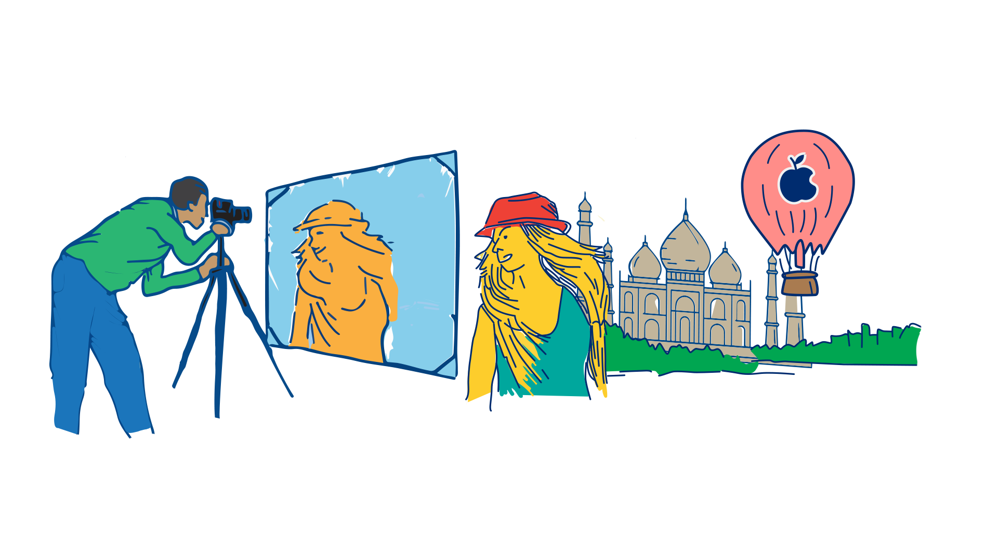
What’s Yours and What’s Not Yours
Author / Owner
Creative Work
Trademarked Logo
Copyrighted
Notes:
Re-created by Dhilan

Slide 21



Licenses
License
Licenses

Slide 22
Data Engineering
Requirements
Gathering
Problem definition
Permissions & rights
Machine & human usable format
People
Collection
Labeling
Data sources
Notes:
Now you have to build the mechanisms and infrastructure to collect the data

Slide 23

Data sources
Sensors
Crowdsourcing
Product users
Paid contributors
Notes:
Data can come from many sources.
Sensors: do you have enough devices deployed with the sensors you need already or will you need to field a lot of new sensors? What are the SWaP constraints? E.g., if you are instrumenting a volcano, how many times will you have to replace batteries?
Crowdsourcing: will enough contributors volunteer?
Product user: do you have their consent? Privacy?
Paid contributors: Mechanical Turk etc
https://thenounproject.com/search/?q=quantity&i=3433022

Slide 24
Data Engineering
Requirements
Gathering
Refinement
Problem definition
Permissions & rights
Machine & human usable format
Data sources
People
Collection
Labeling
Processing
Augmentation
Validation
Notes:
You can’t always use raw data (e.g., audio signals or LIDAR) - you may need to process it further
You need to verify whether the data you collected is good or garbage
Will you need to augment your data?

Slide 25

Some data is
unusable
How will you verify the data you collected?
Manually (time, cost)
Automation
Domain expertise
disputes / disagreements
Notes:
https://thenounproject.com/search/?q=verified&i=2969189

Slide 26
Data Engineering
Requirements
Gathering
Refinement
Sustainment
Problem definition
Permissions & rights
Machine & human usable format
Data sources
People
Collection
Labeling
Processing
Validation
Augmentation
Storage
Security
Errors
Versioning
Notes:
Where will you store your data? How will users access it?
If your data is proprietary, will you be able to prevent unauthorized users from accessing it?
Can users of your data report errors in the dataset back to you?
Your userbase might grow, and you will need to collect more data - new languages, new user demographics, etc
As you collect more data, how will you track versions of your dataset?

Slide 27

Your dataset
will evolve
Missing demographics?
Expanding your user-base?
Notes:
https://thenounproject.com/search/?q=diversity&i=2504341

Slide 28
Data Engineering
Requirements
Gathering
Refinement
Sustainment
Problem definition
Permissions & rights
Machine & human usable format
Data sources
People
Collection
Labeling
Processing
Validation
Augmentation
Storage
Security
Errors
Versioning
Notes:
Where will you store your data? How will users access it?
If your data is proprietary, will you be able to prevent unauthorized users from accessing it?
Can users of your data report errors in the dataset back to you?
Your userbase might grow, and you will need to collect more data - new languages, new user demographics, etc
As you collect more data, how will you track versions of your dataset?

Slide 29
Datasets require
significant effort

Slide 30
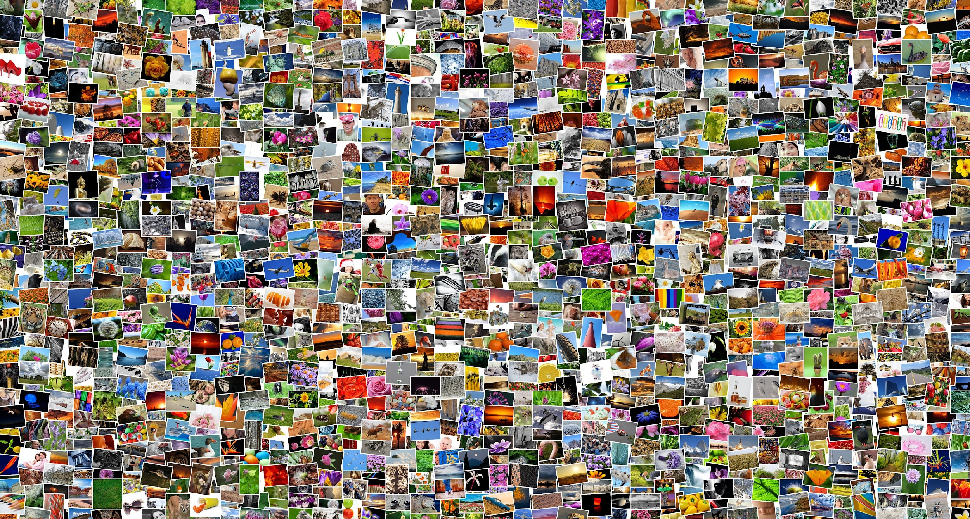

Classifying Images
Notes:
https://pixabay.com/photos/mosaic-images-photos-382019/
https://www.pxfuel.com/en/free-photo-otzgo
http://imagenet.stanford.edu/logo.png

Slide 31
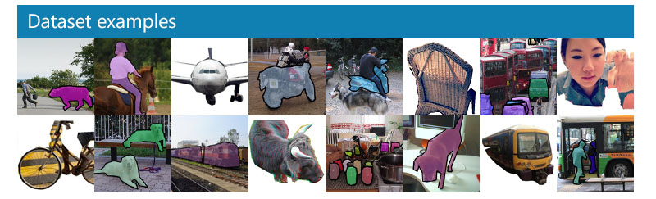
Detecting Objects
Common Objects in Context (COCO)—2.5M+ segmented images
Notes:
https://cocodataset.org/images/coco-examples.jpg

Slide 32
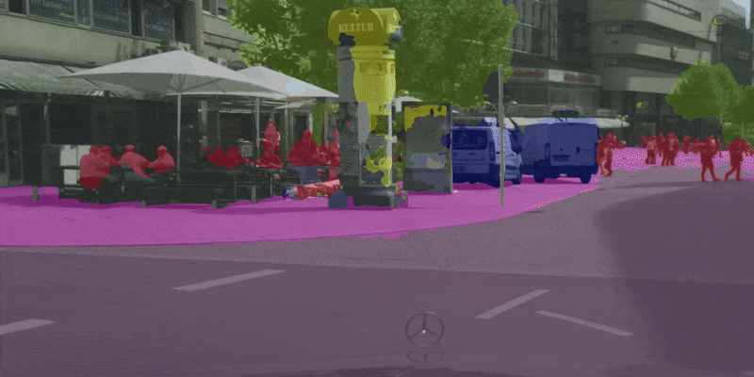
Datasets require significant effort
Waymo—1,950 20-second driving segments (cameras, LIDAR, labels)
KITTI 360—73KM+ of annotated driving data
Notes:
1,950 segments of 20s each, collected at 10Hz (200,000 frames) in diverse geographies and conditions
We recorded several suburbs of Karlsruhe, Germany, corresponding to over 320k images and 100k laser scans in a driving distance of 73.7km.
https://github.com/ekzhang/fastseg/

Slide 33
Datasets require significant effort
These massive machine learning datasets are constructed by hand
Common Voice—5000+ hours of spoken audio
Common Objects in Context (COCO)—2.5M+ labeled images
ImageNet—4M+ labeled images
Waymo—1,950 20-second driving segments
KITTI 360—73KM+ of annotated driving data
Data Engineering: How to build your own dataset?

Slide 34
How do you build your own datasets for TinyML?

